Slide 1

By-
Riya Raymand Rumao
Talent Acquisition Intern (Human Resources)
The Sparks Foundation
#GRIPAUGUST24
#Task 1
RECRUITMENT ARTICLE AND POST

Slide 2

WHAT IS RECRUITMENT ?
The hiring phase of the employee life cycle involves finding, interviewing, and evaluating potential hires to determine who would be the greatest match for a position.
This entails not only filling in vacancies but also predicting talent requirements and proactively managing talent.

Slide 3

Effective Recruitment Strategies
Effective recruitment is crucial for finding the best talent to fuel your company's growth.
This presentation will explore different strategies to attract and hire top candidates.

Slide 4
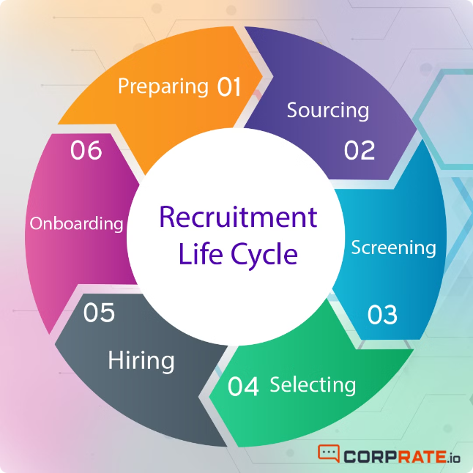
DIFFERENT APPROACHES TO RECRUITING TALENT
1
Traditional Recruiting
Posting job descriptions on job boards and using agencies.
2
Direct Sourcing
Identifying and engaging potential candidates directly through online platforms like LinkedIn.
3
Social Media Recruiting
Using social media platforms to attract and engage candidates.
4
Employee Referrals
Encouraging current employees to refer qualified candidates.

Slide 5



Leveraging LinkedIn for Referrals
Build a Strong Profile
Engage with Your Network
Ask for Referrals
Maintain an updated, professional profile that showcases your expertise.
Actively participate in discussions, connect with relevant professionals, and share valuable content.
Reach out to your connections and ask for recommendations for suitable candidates.

Slide 6
Crafting a Compelling Recruitment Article
Headline
1
A captivating headline that grabs attention and highlights the job opportunity.
2
Company Overview
A brief description of the company, its mission, values, and culture.
Job Description
3
A clear and concise description of the job role, responsibilities, and required skills.
4
Benefits and Perks
Highlighting the attractive benefits and perks offered to employees.
Call to Action
5
Encourage readers to apply for the position and provide clear instructions.

Slide 7





Utilizing Social Media for Recruitment
Facebook
Twitter
Engage a broad audience and establish a connection with possible applicants.
Post job openings and interact with professionals in the field.
Instagram
LinkedIn
Promote your company’s culture to bring in innovative workers.
Reach out to experts in particular fields and establish contact with possible employers.

Slide 8






Developing a Comprehensive Recruitment Plan
Define Goals
Clearly explain the required skill set and number of hires.
Identify Target Audience
Learn and understand the perfect prospect profile.
Choose Recruitment Strategies
Choose the best approaches for your target market and costs.
Develop Marketing Materials
Write attractive job descriptions, messages on social media, and other promotional materials.
Track and Analyze
Track hiring activities and make any necessary strategy adjustments.

Slide 9
Identifying Ideal Candidate Profiles

Slide 10
Simplifying the Application Process
Easy-to-use Application Form
Automated Screening
Quick Feedback
Reduce the amount of information needed and simplify the application process.
Utilize technology to screen applications according to predefined requirements.
During the process, give candidates periodic updates.

Slide 11



Fostering a Positive Candidate Experience
Personalized Communication
Professional Interview Process
Transparent Decision-Making
Answers questions as soon as possible and give relevant updates.
Organize interviews and give candidates a chance to demonstrate their abilities.
Make the hiring choice clear as soon as possible, and give precise comments.

Slide 12
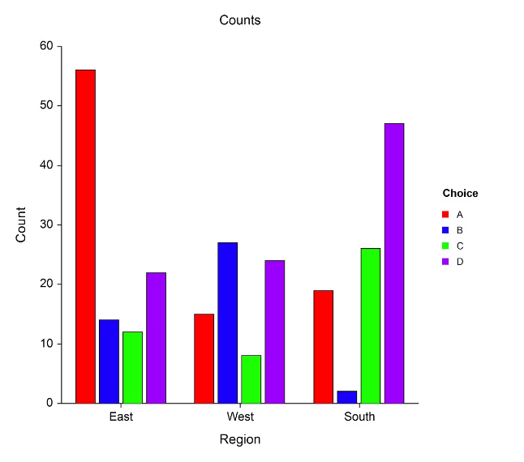
Assessing and improving Recruiting Activities.
1
Time-to-Hire
2
Cost-per-Hire
Track the time it takes to fill open positions.
Calculate the cost of recruiting and hiring a new employee.
3
Candidate Satisfaction
4
Employee Retention
Gather feedback from candidates to identify areas for improvement.
Measure how long new hires stay with the company.

Slide 13

Conclusion
Using a comprehensive recruiting plan that uses several channels, such as LinkedIn recommendations and social media, can greatly increase the likelihood of attracting top talent for the business you run.
Adopt a creative mindset, remain flexible, and constantly remember that establishing sincere rapport with applicants is essential for long-term recruiting success.

